Slide 1
Ulwazi mayelana nokumelana nemishanguzo yegcikwane lesandulela ngculazi

Slide 2
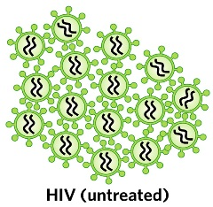
Kuyini ukumelana nemishanguzo yegcikwane lesandulela ngculazi?
Uma umuntu etheleleka ngegciwane lesandulela ngculazi,Ingciwane lingena emzimbeni womuntu bese liqala ukwenza umfanekiso walo.

Slide 3
Kuyini ukumelana nemishanguzo yegcikwane lesandulela ngculazi?
Imishanguzo esetshenziselwa ukwelapha igciwane lesandulela ngculazi ibizwa ngama antiretrovirals (ARVs).
Notes:
Ukuthatha ama-ARVs ngendlela kusho ukuthi uthatha izinhlobo eziwu 3 ezihlukene, ngoba kuthatha ngaphezulu komuthi owodwa wama-ARVs ukuvimbela igciwane lesandulela ngculazi ukuthi iziphindaphinde.

Slide 4
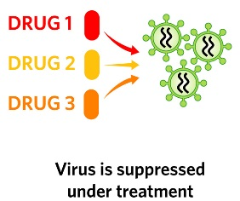
Kuyini ukumelana nemishanguzo yegcikwane lesandulela ngculazi?
Uma ethathwe ngendlela, ama-ARVs ayalivimba igciwane ukuthi lingaziphindaphindi bese asize abantu abanegciwane lesandulela ngculazi ukuthi bazizwe bengcono baphile isikhathi eside.

Slide 5
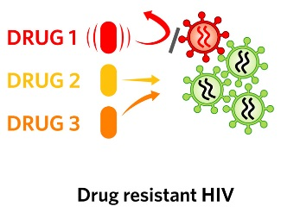
Nakuba kunjalo ama-ARVs awulungile ngokuphelele, futhi ngezinye izikhathi awakwazi ukumisa wonke amagciwane egcikwane lesandulela ngculazi ukuthi aziphindaphinde.
Kuyini ukumelana nemishanguzo yegcikwane lesandulela ngculazi?

Slide 6
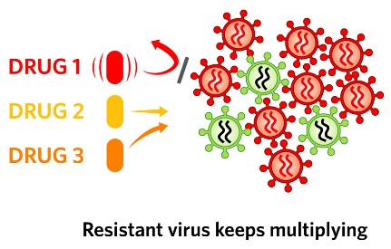
Uma lokhu kwenzeka, iHIV ikwazi ukuqhubeka ukuziphindaphinda libizwa “ukumelana“.
Kuyini ukumelana nemishanguzo yegcikwane lesandulela ngculazi?

Slide 7
Kungani ukumelana nemishanguzo yama-ARVs kuyinkinga?
Uma ukumelana nama-ARVs kwenzeka, umuntu udinga ukuyeka ukuthatha ama-ARVs angasasebenzi bese eqala ukuthatha imishanguzo yamaARVs ahlukile.

Slide 8
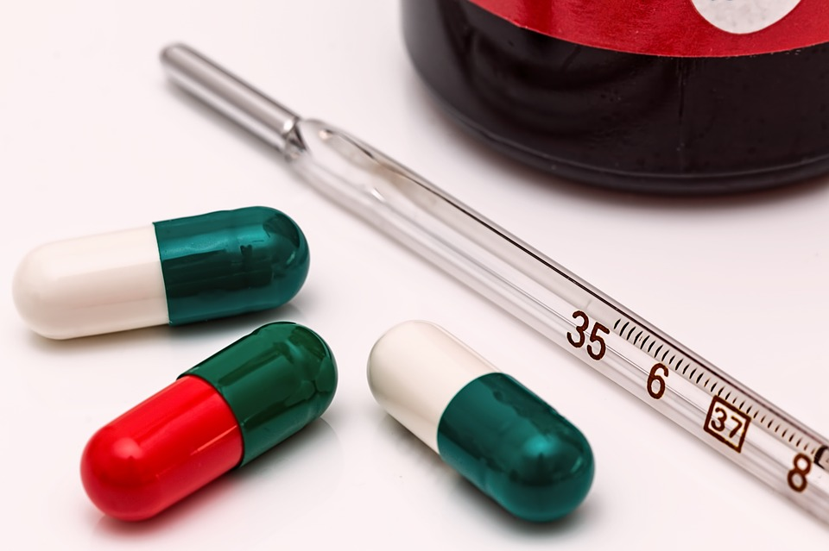
Kungani ukumelana nemishanguzo yama-ARVs kuyinkinga?
Ngenxa yalokhu, umuntu oneHIV enokumelana unokuzikhethela okumbalwa kwemishanguzo yama-ARVs angawathatha ukusizakala ukuthi bahlezi bephilile.
Ngaphezu kwalokho, bangathelela abanye ngaleligciwane elinokumelana.

Slide 9
Kungani ukumelana nemishanguzoyama-ARV’s kuyinkathazo kulolucwaningo?
Iringi yesitho sangasese sowesifazane sangaphambili iqukethe ama-ARVs abizwa ngeDapivirine. IDapivirine isetshenziselwa kuphela ukuvikela igciwane lesandulela ngculazi, futhi ayisetshenziselwa ukwelapha abantu asebethelelekile ngegciwane lesandulela ngculazi.

Slide 10
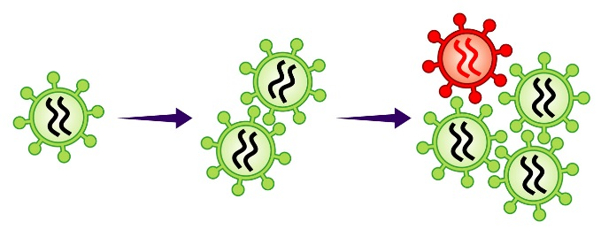
Kungani ukumelana nemishanguzoyama-ARV’s kuyinkathazo kulolucwaningo?
Nokho, uma owesifazane etheleleka ngegciwane lesandulela ngculazi futhi elokhu esebenzisa iringi, igciwane emzimbeni wakhe lingaba nokumelana nedapivirine kanye nemishanguzo ecishe ifane nama-ARV asetshenziselwa ukwelapha igciwane lesandulela ngculazi noma ukuvimbela ukutheleleka kwengane nomama ngegciwane lesandulela ngculazi.

Slide 11
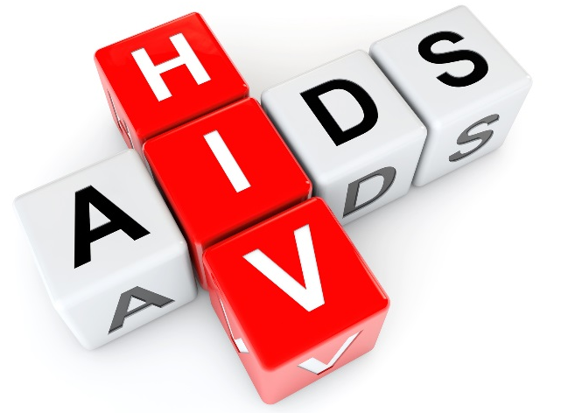
Kungagwenywa kanjani ukumelana nemishanguzo yama-ARV ngesikhathi ubambe iqhaza kuHOPE?
Gwema Ukuthola igciwane lesandulela ngculazi:
Ukumelana nemishanguzo yama ARV ngeke kwenzeke kumuntu ongenalo igciwane lesandulela ngculazi.
Notes:
Ziningi izinto ongazenza ukunciphisa ubungozi bokutheleleka ngeHIV:

Slide 12
Kungagwenywa kanjani ukumelana nemishanguzo yama-ARV ngesikhathi ubambe iqhaza kuHOPE?
Sebenzisa idapivirine iringi yesitho sowesifazane sangasese sangaphambili njalo
Sebenzisa amakhondomu njalo

Slide 13
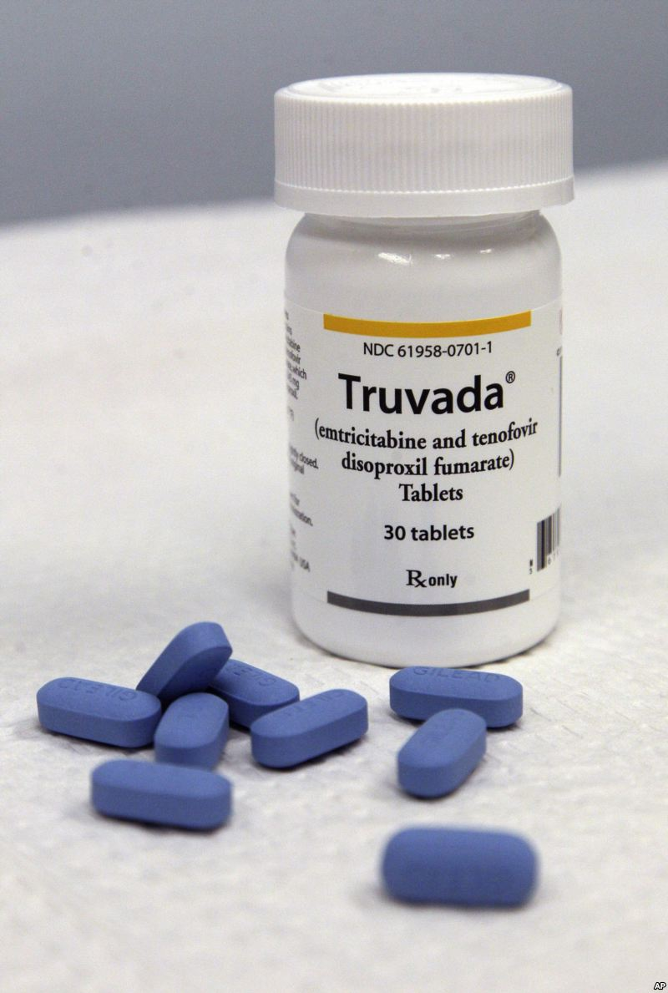
Kungagwenywa kanjani ukumelana nemishanguzo yama-ARV ngesikhathi ubambe iqhaza kuHOPE?
Sebenzisa iPrEP ephuzwayo (e.g. Truvada)
Nciphisa isibalo sakho sophathina bocansi
Zibandakanye ezindleleni zocansi ezinobungozi obuphansi

Slide 14
Kungagwenywa kanjani ukumelana nemishanguzo yama-ARV ngesikhathi ubambe iqhaza kuHOPE?
Uma uneSTI (isifo esithelelana ngokocansi), thola ukwelashwa
Gqugquzela uphathina wakho ukuthi ahlolelwe igciwane lesandulela ngculazi.
Uma uphathina wakho enegciwane lesandulela ngculazi, mugqugquzele ukuthi ayithathe ngendlela imishanguzo yakhe yama-ARVs.
Notes:
Buza umeluleki ngezincwajana ezinikezwayo zo “Ulwazi mayelana nezindlela zokuvikela iHIV ongakhetha kuzo” ngolunye ulwazi olwengeziwe kulezindlela.

Slide 15
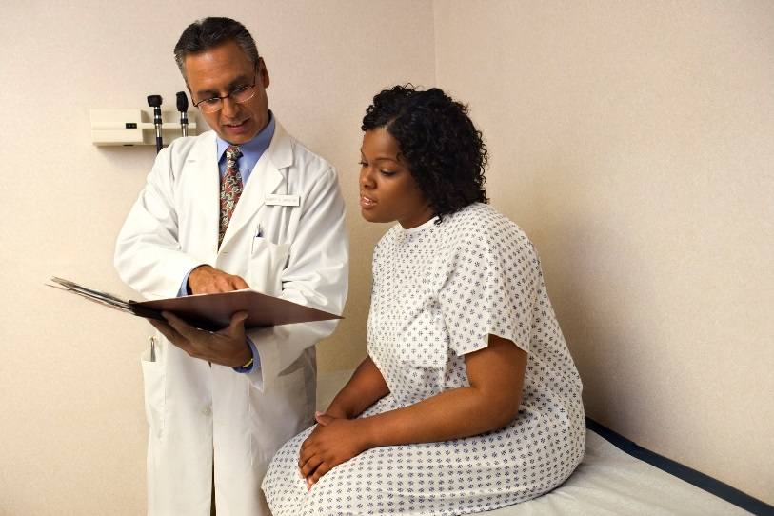
Kungagwenywa kanjani ukumelana nemishanguzo yama-ARV ngesikhathi ubambe iqhaza kuHOPE?
2. Jwayela ukuhlolela iHIV:
Ukuhlolwa kwegciwane lesandulela ngculazi kuzokwenzeka njalo ekuvakasheni kwakho ocwaningweni.
Kumele futhi uze ekliniki uzohlolela igciwane uma ucabanga ukuthi kungahle kube uthelelekile ngegciwane lesandulela ngculazi maphakathi nokuvakasha kwakho.

Slide 16
Kungagwenywa kanjani ukumelana nemishanguzo yama-ARV ngesikhathi ubambe iqhaza kuHOPE?
Uma ukuhlola kuveza ukuthi unegciwane lesandulela ngculazi, kubalulekile ukuyeka ukusebenzisa iringi yesitho sowesifazane sangasese sangaphambili ngokushesha ukusiza ukuvimbela ukumelana.
Notes:
Uma ephuthwa ukuvakasha kocwaningo, umbambiqhaza angase atheleleke ngeHIV angabi nalwazi ngalokhu futhi aqhubeke asebenzise iringi. Lokhu kungabanga ukumelana neminye yemishanguzo yama-ARVs.

Slide 17
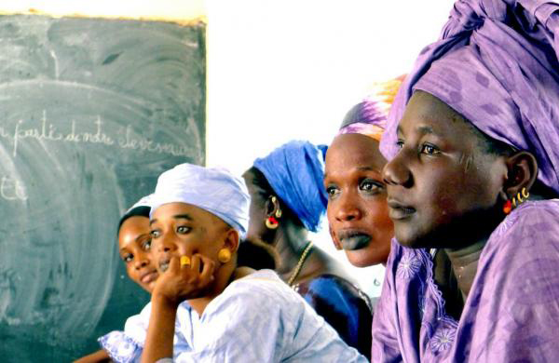
Kungagwenywa kanjani ukumelana nemishanguzo yama-ARV ngesikhathi ubambe iqhaza kuHOPE?
3. Ungabelani ngamaringi esitho sowesifazane sangasese sangaphambili:
Ababambiqhaza kulolucwaningo bathola njalo ukuhlolwa kwezempilo nokuhlolwa kwegciwane lesandulela ngculazi. Abantu abangekho ocwaningweni abakutholi lokhu kuhlolwa kwezempilo. Labantu bangaba negciwane lesandulela ngculazi futhi bengakwazi lokhu.
Notes:
Uma abantu abaneHIV besebenzisa iringi yesitho sowesifazane sangasese sangaphambili, lokhu kungabanga ukumelana neminye imishanguzo yama-ARVs.

Slide 18
Uma unemibuzo noma udinga ulwazi olwengeziwe, sicela uvakashele eklinikhi yocwaningo.
Abasebenzi bocwaningo bakhonela ukukusiza
Notes:
Abasebenzi bocwaningo bakhonela ukukusiza.
Abasebenzi bocwaningo bakhona ukukwazisa nokweluleka ababambiqhaza ocwaningweni, ophathina babo, kanye namanye amalungu omphakathi mayelana nokumelana nemishanguzo yama-ARV kanye nanoma imiphi imibuzo noma ukukhathazeka abangase babe nakho.

